Slide 1
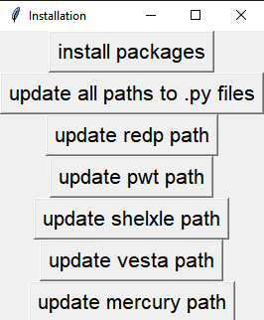

Prepare
Requirements:
Install windows subsystem for linux (wsl), install XDS package, install Python.
Put XPREP, shelxt, xcif in a folder, and put the path to this folder into PATH in environment variables.
Put edtools_gui.py, evaluation.py, comment.py, update_mosaicity.py, solution.py, plot_scale.py, table.py, table.docx, LMPeng1999_SHELX.txt files into a folder.
Open “install_edtools_gui.py” script, click “install packages”, the code will detect the default environment of python, and install edtools package, pyperclip, prettytable, pyautogui, docx modules automatically in that environment.
Select the folder that containing edtools_gui.py, evaluation.py, comment.py, update_mosaicity.py, solution.py, plot_scale.py, table.py, table.docx, LMPeng1999_SHELX.txt files, the code will update the paths to these files.
Click “update redp path”, select the redp.exe file in your computer, the code will update the path to redp software in corresponding .py files. Do the same thing to update paths to pwt, shelxle, vesta, and mercury softwares.
Note: the path to the .py files should not contain empty space!!!

Slide 2

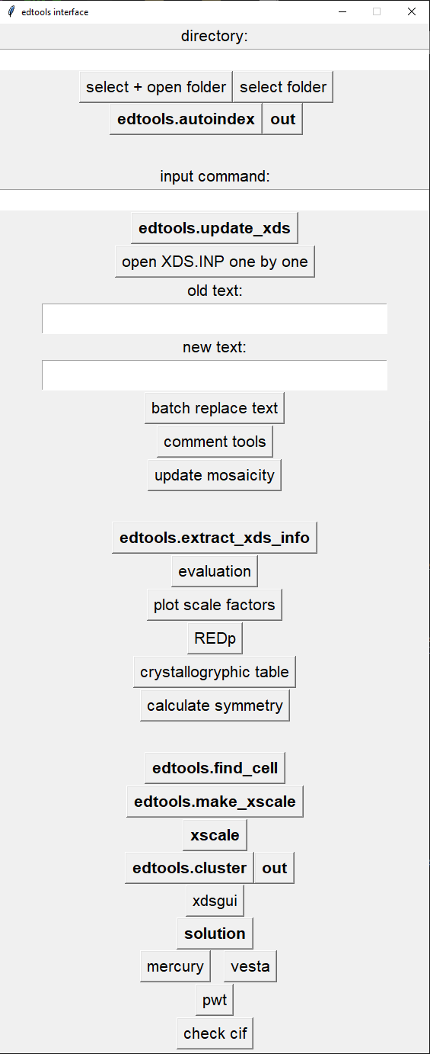
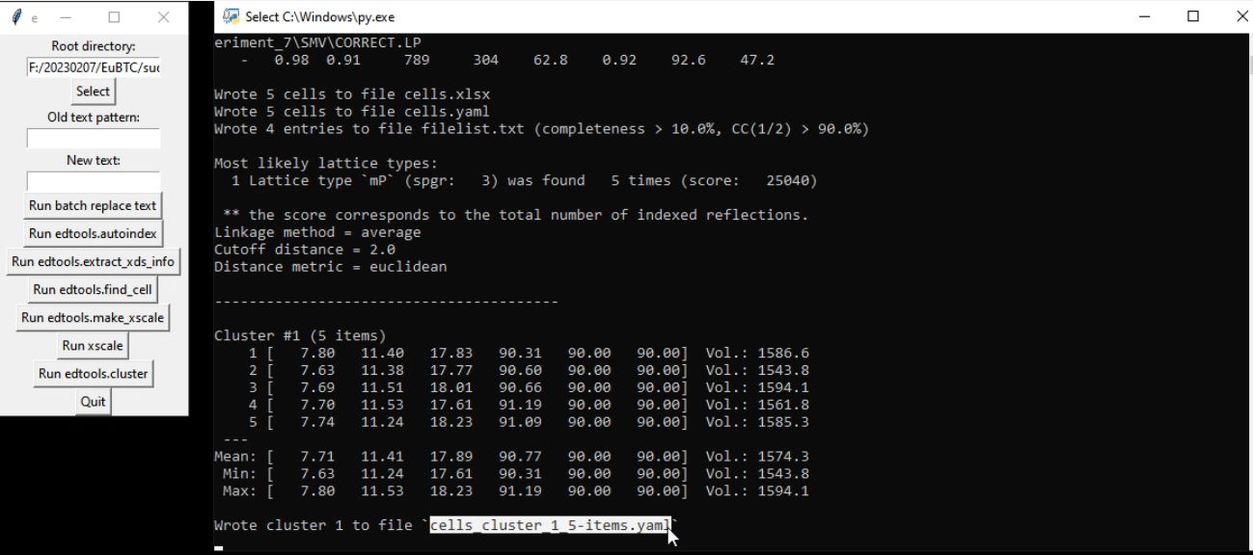
Batch data processing
Open the edtools_gui.py file with Python software. (Double-click the icon if Python software is the default software to open .py files on your computer)
Click “select + open folder” button to choose the folder that has all 3DED data. A file explorer window of the selected folder will automatically pop out. If click “select folder”, the explorer window will not pop out.
Click “edtools.autoindex”, edtools will index every dataset based on XDS.INP files in the root cmd window. Click “out”, a new cmd window will pop out and run autoindex command, which is used when you have a large amount of datasets. It is faster in new cmd window.
Click “edtools.extract_xds_info”, indexing result will be extracted in an excel file.
Click “edtools.extract_find_cell”, clustering based on unit cell parameters will be conducted.
Select and right-click on the cells_cluster you want to process. (the information is stored in the pasteboard).
Click “edtools.make_xscale”, XSCALE.INP file will be created.
Click “xscale”, scaling will be conducted.
Click “edtools.cluster”, clustering based on CC1/2 will be conducted, and the datasets will be grouped and merged.
Click “solution” to solve the structure, details see the last slide.
Step 1
Step 2
Step 3
Step 5: select and right-click
Step 4
Step 6
Step 7
Step 8
Step 9

Slide 3
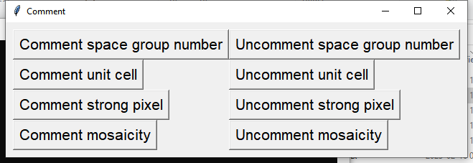
Input command (e.g. –r 20 1.0)in the window, then click “edtools.update_xds”, the code will run “edtools.update_xds –r 20 1.0” command. You can use “-h” command to check all the commands for edtools.update_xds.
Click “open XDS.INP one by one” button, the code will find all XDS.INP file in current selected folder and print the content of one XDS.INP file every time you click the button. You can copy the part you want to change, paste it in the “old text” window, input the new part in the “new text” window, and then click “batch replace text” button. The old text will be replaced by the new text in all XDS.INP files.
Click “comment tools”, a new window will pop out. Click on these buttons till add or delete “!” before the corresponding words in all XDS.INP files.
Click “update mosaicity”, the code will find the “BEAM_DIVERGENCE= 0.15699 BEAM_DIVERGENCE_E.S.D.= 0.01570 REFLECTING_RANGE= 2.26489 REFLECTING_RANGE_E.S.D.= 0.32356” in all INTEGRATE.LP files and insert it to the top of the corresponding XDS.INP files.
Batch update XDS.INP files
Option 1
Option 2
Option 3
Option 4

Slide 4
Single dataset processing
Click “select+open folder” or “select folder” button to choose the folder that has all 3DED data.
Click “edtools.autoindex”, edtools will index every dataset based on XDS.INP files.
Click “edtools.extract_xds_info”, indexing result will be extracted in an excel file and also in the cmd window.
Click “evaluation”, the code will find all the CORRECT.LP files in the selected folder, search for the statics in the last run, write these lines into a “evaluation.txt”, and immediately open this txt file. The code will also find all IDXREF.LP files, search for the lines “INDEXING OF OBSERVED SPOTS IN SPACE GROUP” and write the values into “evaluation.txt”. Check the extracted information in step 3 (shown in the cmd window) and in step 4 (shown in “CORRECT evaluation.txt”, you will get a rough idea about which dataset is the best.
If you find out the best dataset has high resolution and high completeness, click “select folder”, choose the subfolder of the best dataset. The chosen subfolder should have XDS.INP file in it. Usually the folder name should be “SMV”.
Click “xdsgui”, a cmd window for xdsgui will pop out. (make sure you use the default English input method on your computer!). This step is optional.
Click “plot scale factors”, the code will draw a plot of scale factors vs image number, you can pick two spots (e.g. n1 n2) to select the range that scale factors are abnormal (close to 1 is normal). The code will directly write “exclude n1 n2” in the XDS.INP file. You can also click “REDp” to run REDp software to check the space group and unit cell. Click “crystallographic table” you can choose to print the tables in different systems.
Based on above information, change XDS.INP file parameters (the same operations in the previous slide).
Click “edtools.autoindex” to redo index. The shelx.hkl will be automatically generated.
Click “solution” to solve the structure, details see next slide.
Check the structure model with mercury, vesta, pwt, and check cif.
Step 1,5
Step 2,9
Step 8
Step 3
Step 4
Step 7
Step 6
Step 10
Step 11

Slide 5
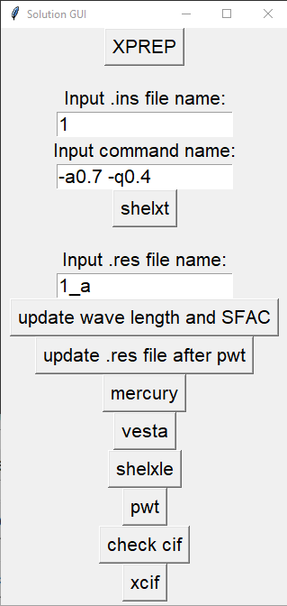
Solve the structure
Requirement: the selected folder must contain .hkl file and XDSCONV.lp file!!!
Click “select folder” to select the folder with both .hkl file and XDSCONV.LP file.
Click “solution”, a new gui will pop out.
Click “XPREP”, the code will first check if the if current folder is “solution”. If it is, go upper folder, find XXX.hkl file, create a new subfolder named “solution”, copy this XXX.hkl file into the “solution” subfolder, create a XXX.p4p file, read the unit cell in XDSCONV.LP file, write the unit cell into XXX.p4p file, and then run “XPREP XXX” command under “solution” subfolder. If it is not, do the same thing in current folder.
Step 1
Step 3
Step 2

Slide 6
Solve the structure
Requirement: the selected folder must contain .hkl file and XDSCONV.lp file!!!
Manually do XPREP, remember to save the hkl file with a new name, e. g. “YYY”. After XPREP, YYY.hkl, YYY.ins, and YYY.prp will be produced in current folder.
Type YYY in “Input .ins file name:” window, then click “shelxt”, the code will first check if YYY.hkl, YYY.ins, and YYY.prp files are in “solution” folder, if they are, directly run “shelxt YYY”, if they are not go upper folder to move YYY.hkl, YYY.ins, and YYY.pcf files from SF to “solution” subfolder, and run “shelxt YYY”.
You can also type commands (e. g. –a0.7 –q0.4) in the “Input command name” window, then click “shelxt” , the code will run “shelxt YYY –a0.7 –q0.4” command.
Input the .res file name you want to update, click “update wave length and SFAC”, the wavelength and SFAC will be updated to electron version. (wavelength will be changed to 0.0251, SFAC will be extracted from LMPeng1999_SHELX.txt file based on the existing elements in .res file).
Click “mercury” or “vesta”, the code will open corresponding software. You can check the structure model.
Click “shelxle”, shelxle.exe will be opened for the refinement of the structure model.
Click “pwt”, to open pwt.exe. It is used to check the symmetry of the structure model. In pwt.exe, click “File”, choose file with “select data file”, then click “Publish”, click “ADDSYM SHELX”, YYY_pl.res file with updated symmetry will be generated.
Click “update .res file after pwt”, the code will copy the content in YYY_pl.res file and overwrite YYY.res file. After overwriting, “update wave length and SFAC” will be operated automatically. YYY comes from the “Input .res file name:” window!!!
Click “check cif”, the http://checkcif.iucr.org/ website will be opened.
Click “xcif”, xcif software will be opened. It is used to extract the detailed parameters from YYY.cif file. YYY comes from the “Input .res file name:” window!!!
Step 5
Step 6
Step 7
Step 11
Step 8
Step 9
Step 10
Step 12
Step 13

